Slide 1

Introduction to The New PA Delivery Model
Notes:
Instructor Notes:
- Unit Introduction

Slide 2
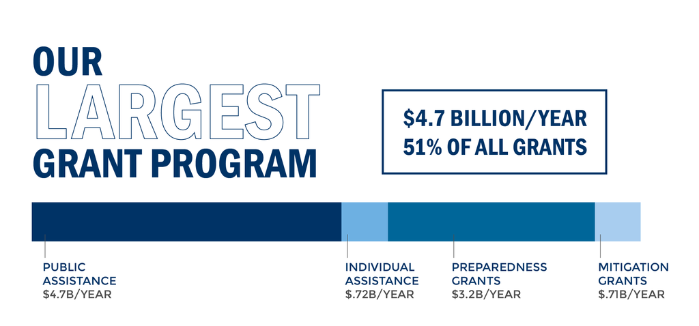
Introduction to The New PA Delivery Model
Notes:
Instructor Notes:
- Orientation slide to show that the program is the largest component of grant funding within FEMA and that the Public Assistance Program is a large enterprise that has required a leaner delivery approach in order to execute the mission better.

Slide 3
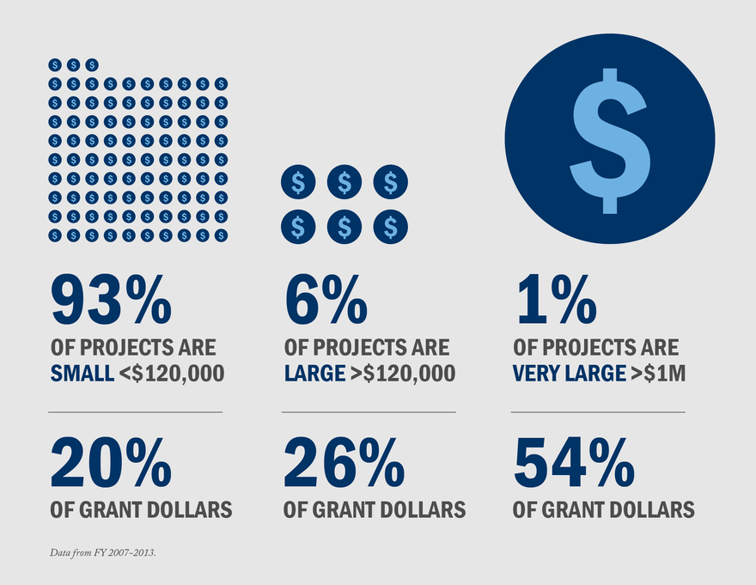
Introduction to The New PA Delivery Model
Historically…
Notes:
Instructor Note:
- Share with Applicants that FEMA realizes no two projects, applicants, or disasters are alike. Projects vary in type of work, complexity, considerations and cost.

Slide 4
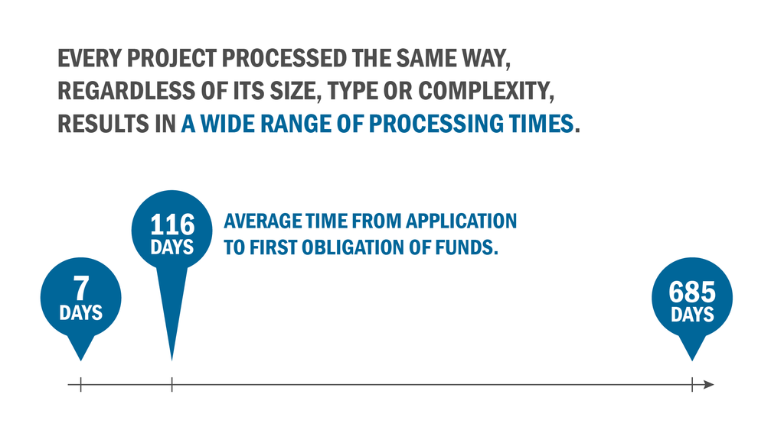
Introduction to The New PA Delivery Model
Historically…
Notes:
Instructor Note:
- Share with Applicants that FEMA realizes no two projects follow the same funding lifecycle.

Slide 5
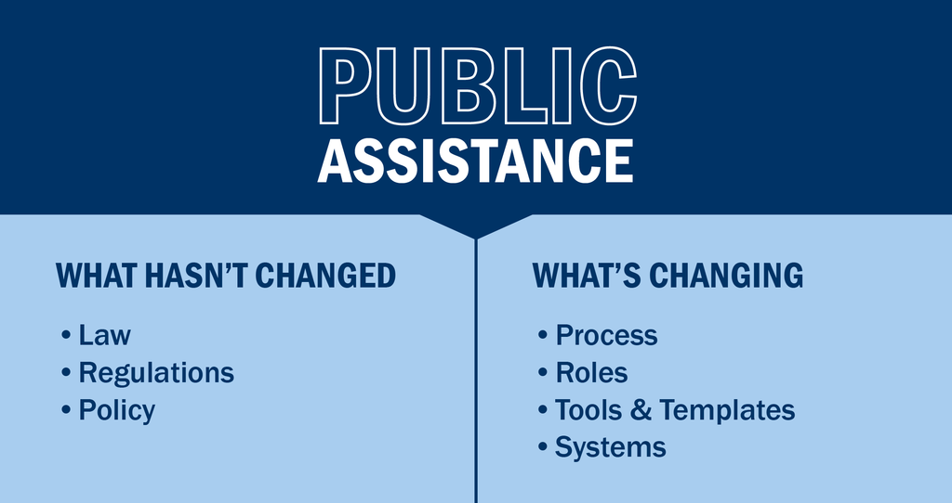
Introduction to The New PA Delivery Model
Notes:
Instructor Note:
- Reinforce that Program Policy/Rule/Law is not changing.
New Delivery Model focuses on Program Delivery Only.

Slide 6
Introduction to The New PA Delivery Model
Through the New Delivery Model, We are focusing on:
Customer Service
Project Specific Complexity
Customer Specific Needs
Overall Recovery Priorities
Consistency
Specialization
National Standards
A Platform for Continuous Improvement
Notes:
Instructor Notes:
Instructor should expand into a brief discussion on each bullet point in order to articulate each point to the audience.
Inform participants that the Model is built for enhanced performance, and will include continuous improvements from lessons learned over time in order to achieve maximum potential.
Discuss the phases of delivery as a method for initial lessons learned prior to full scale national implementation (Beta Test in Iowa, Stage 1 in Oregon, Stage 2 in Georgia, etc.)

Slide 7

Introduction to The New PA Delivery Model
Recipients and Applicants
Have a direct role
Customer Engagement
Transparency
Front-end Agreement
Project Development
This Course will orient you with FEMA’s New Direction, while providing tools, resources, and information to enhance Applicant/Recipient recovery operations
Notes:
Instructor Note:
Expand from the previous slide to show the class that the program delivery remains an Applicant Driven Process.
Participation from partners will be essential in accomplishing the Mission and throughout the 2 day course, Applicants and Recipients will be shown their roles (and/or Roles they can engage in) to enhance success.

Slide 8
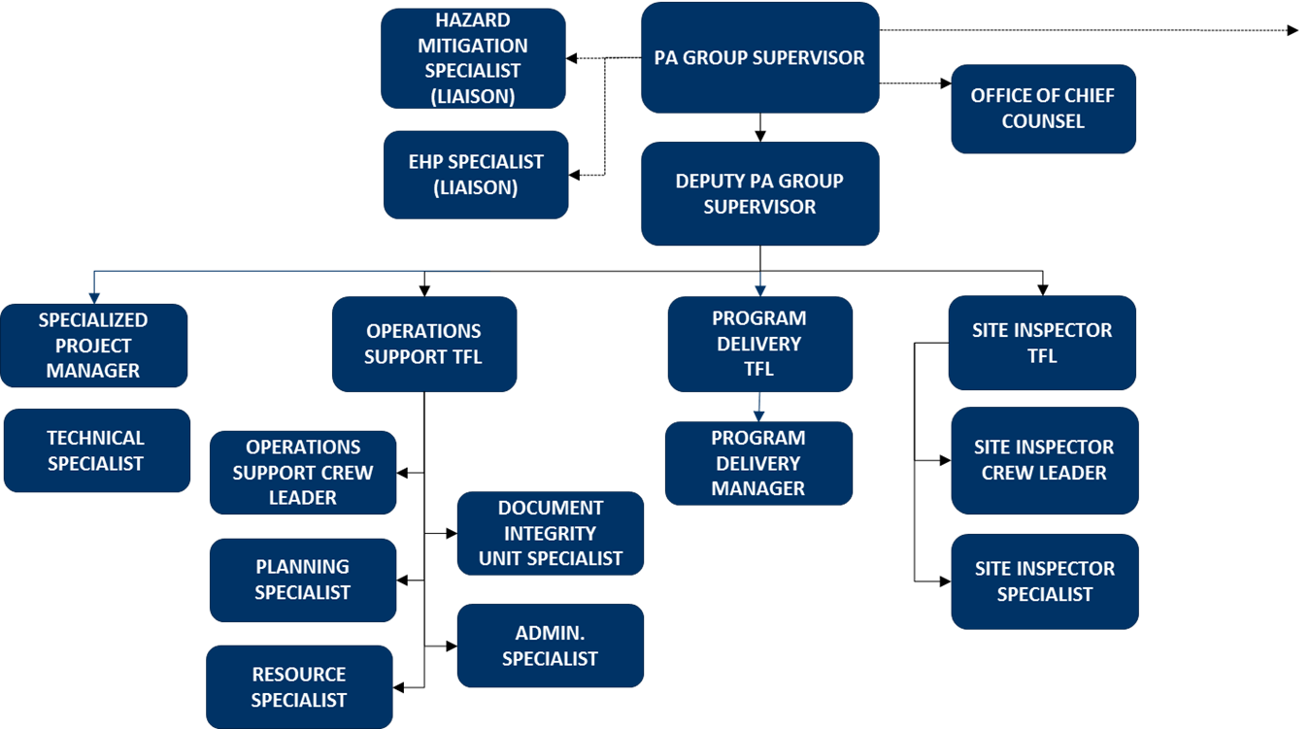
Operational Framework
FEMA Field Level Operational Structure
Notes:
Instructor Note:
Introduce that the Program Delivery Manager will be the Applicant’s Primary POC.
Following the next slide (showing the CRC Org Chart), a crosswalk and deeper look at the Program Delivery Manager Role is facilitated for deeper discussion and orientation.
Similar is facilitated for the Site Inspector Role following the PDMG Slide.
SPECIAL INSTRUCTOR NOTE: Comment that PDMGs and Site Inspectors are who Applicants and Recipients will see and interact with in the field.

Slide 9
Operational Framework
Introduction – PDMG
Develops an Applicant Relationship
Dedicated primary FEMA Point of Contact
Expected to remain in place through entire disaster
Facilitates EC and RSM
Assists with DI Development
Facilitates Document Collection and Coordination
Notes:
Instructor Notes:
Specify to the audience that the PDMG Role is a customer service centered approach and that all efforts of the Program Delivery Manager are directed at assisting the Applicant. Program Delivery Managers serve as the face of the Agency, as well as the Bridge between any unmet needs/requests either from the Applicant, or the Consolidated Resource Center.
Program Delivery Managers focus on Applicant needs, without the administrative distraction of managing staff.
Emphasize that PDMGs, as a condition of minimum performance, are expected to meet with applicants within minimum benchmarks and it is preferred that PDMGs meet with Applicant’s weekly.
Lead in to potential Recipient job roles: Recipients with sufficient staff may be able to partner and mirror the Program Delivery Manager as the Applicant Advocate. Assist with the process.

Slide 10
Operational Framework
Introduction – FEMA SI
Receives Site Inspection WO
Facilitates Site Inspections / Collects Dimensions.
Assembles a Report Package with Photos, Maps, and Sketches
Crafts Damage Description from the SIR
Notes:
Instructor Notes:
In discussion of the crosswalk, emphasize to the audience the Applicant/Recipient benefit of the manageable and defined roles of the New PA Model.
Inform the Audience that roles concerning the Site Inspector, Applicant and Recipient will be discussed in greater detail through Unit 4.
Highlight that Recipients with sufficient staff may be able to partner, mirror and assist Site Inspectors during the Process.
Highlight that Site Inspectors now focus on manageable assignments within their defined skillset. Refined job role within a manageable span of control

Slide 11
Operational Framework
FEMA CRC Structure
PA Consolidated Resource Center Deputy Director
Completed Lane Lead
Standard Lane Lead
Document Integrity Unit Lane Lead
Specialized Lane Lead
Program Compliance Manager
Validation Specialist
Costing Specialist
Technical Specialist
Document Integrity Unit Specialist
Quality Assurance Specialist
Hazard Mitigation Liaison
EHP Liaison
Insurance Specialist
PA Consolidated Resource Center Director
Notes:
Instructor Note:
The CRC Construct is designed to specialize work into groups (lanes) depending on complexity.
Inform the Audience that we will be discussing how this is determined through work between the Applicant and the Program Delivery Manager in the field.
Additional functions in the CRC include the Document Integrity who ensures all Essential Elements of Information/Documentation are captured, and the Compliance Unit who facilitated project review and quality control.

Slide 12
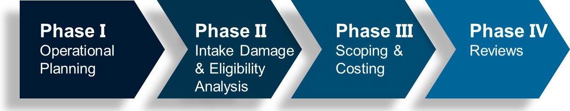
New PA Project Phases
Moving forward through the course, we will:
Take a deeper look at each phase
Describe the FEMA Role
Demonstrate the Applicant Roles
Identify potential Recipient Roles
Notes:
Instructor Note: Take a few brief moments to discuss each phase. Tie a “General Idea” of function to each phase to set a foundation.
- Projects are now processed through an assembly line.
- Specialized and skilled personnel are aligned to each task.
- The process is streamlined.
- Span of control is established.
Phase I: Operational Planning: The identification of disaster impacts and Applicant recovery priorities.
Phase II: Intake Damage and Eligibility Analysis: Codify the disaster related damages – completion within 60 days of the Recovery Scoping Meeting (RSM). Facilitation of Site Inspections.
Phase III: Scoping and Costing: Development and validation of Applicant provided Scopes of Work and costs based on codified damage.
Phase IV: Reviews: Eligibility review queues and project obligation.

Slide 13
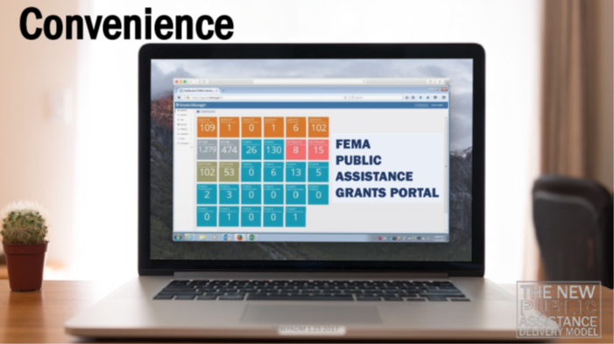
Introduction to The New PA Delivery Model
The Public Assistance Grants Portal:
Developed to assist the Applicant and Recipients
Facilitates full project visibility
Enhances coordination and communication
User friendly - streamlines work and workflow
Significantly improves document collection and retention
By the conclusion of this course, all participants will be familiar with the Grants Portal.
Notes:
Instructor Notes:
Introduce the Grants Portal
Through the following slides, everyone will upload necessary software and establish accounts.

Slide 14
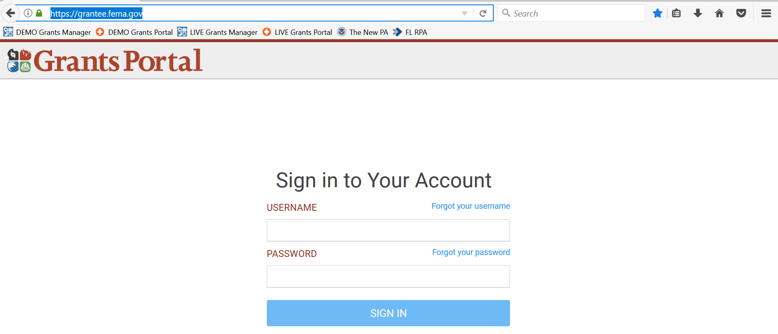
Login Screen
https://grantee.fema.gov
Notes:
General Log on screen to https://grantee.fema.gov
First Recipient specific actions will be covered then Sub/Applicant, they will be showed together when they follow the same steps.

Slide 15
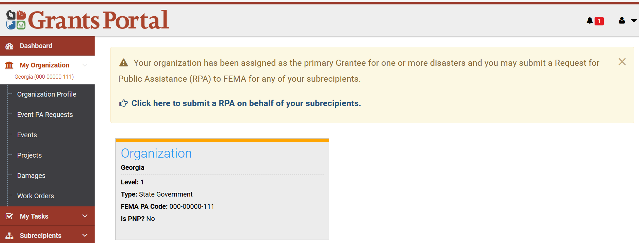
Recipient “Dashboard” Screen
Profile
Notes:
Recipient Dashboard: Show Tiles as while as the ability to “Click here and submit a RPA on behalf of your subrecipients”

Slide 16
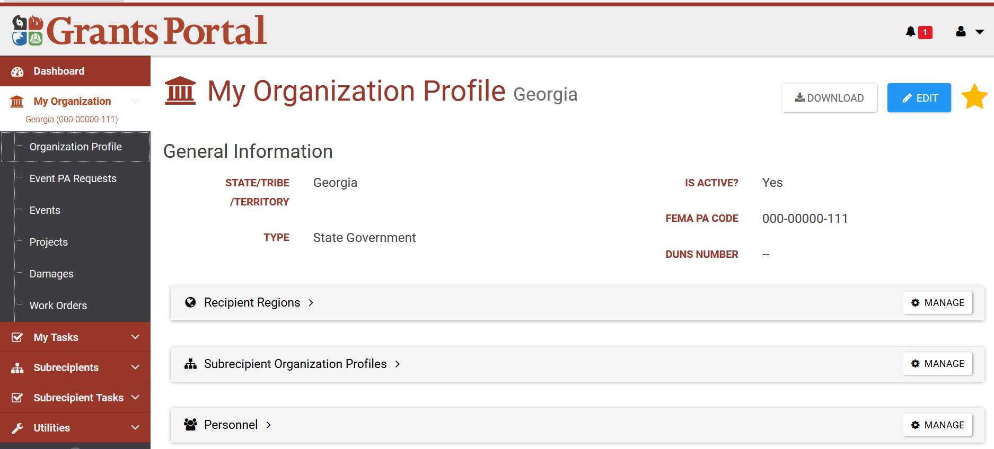
Recipient “My Organization” Area
Profile / Organization Profile
Notes:
Organization Profile – Will review Recipient Regions, Subrecipient Organization Profiles, and Personnel in further detail.
Blue boxes indicate where you entered that section, red boxes call out where the action is going to take place.

Slide 17
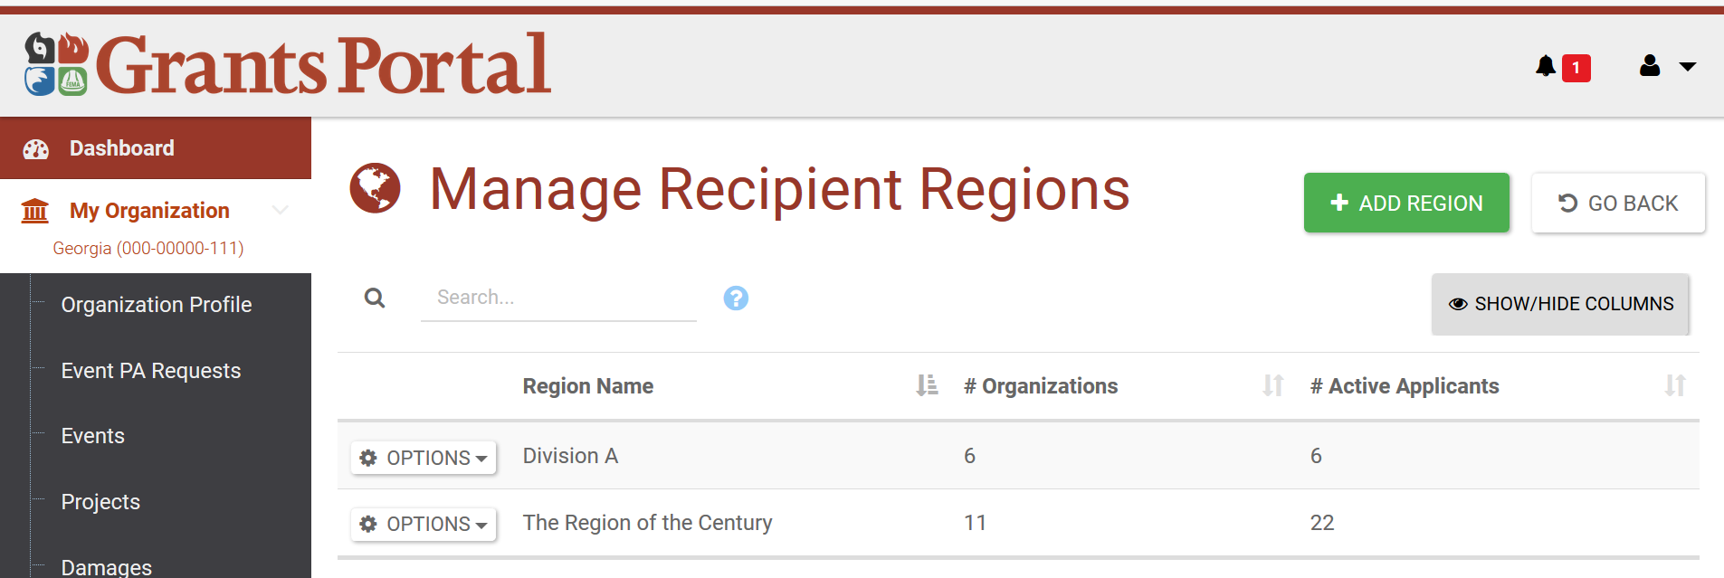
Recipient “Recipient Regions” Area
Profile / Organization Profile / Recipient Regions
Notes:
Showing how to add a Region: Select + ADD REGION

Slide 18
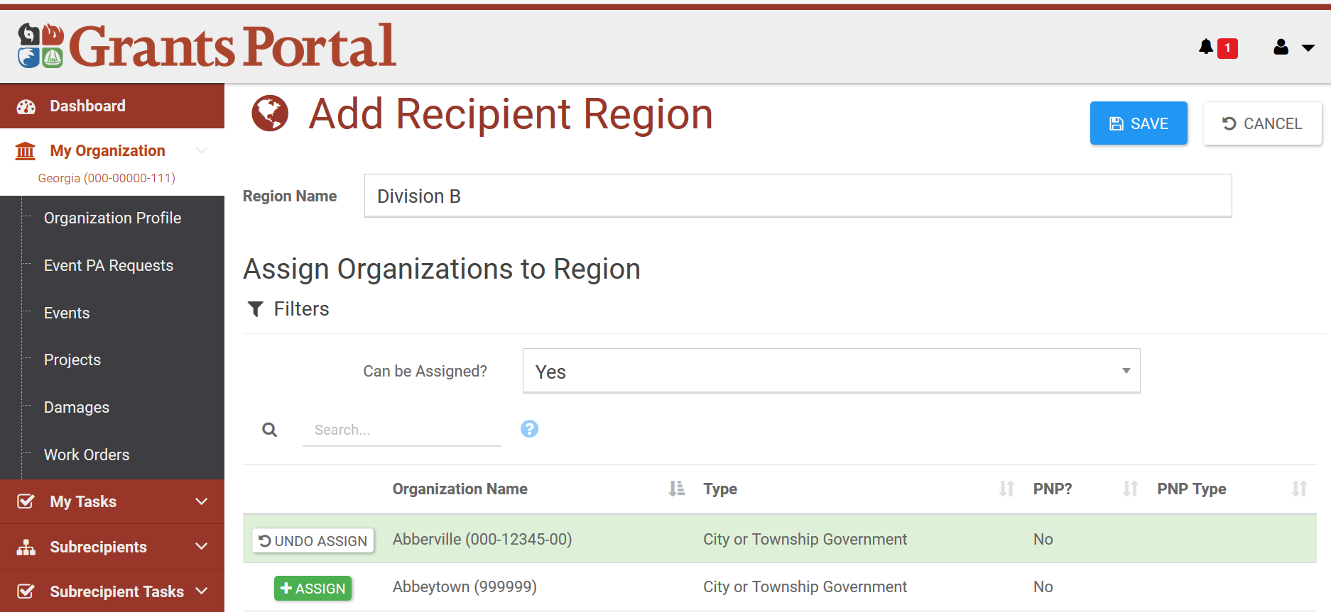
Recipient “Recipient Regions” Area
Profile / Organization Profile / Recipient Regions / Add Region
Notes:
When adding a region, they enter a Region Name then assign an Organization(s) to the newly created region.

Slide 19
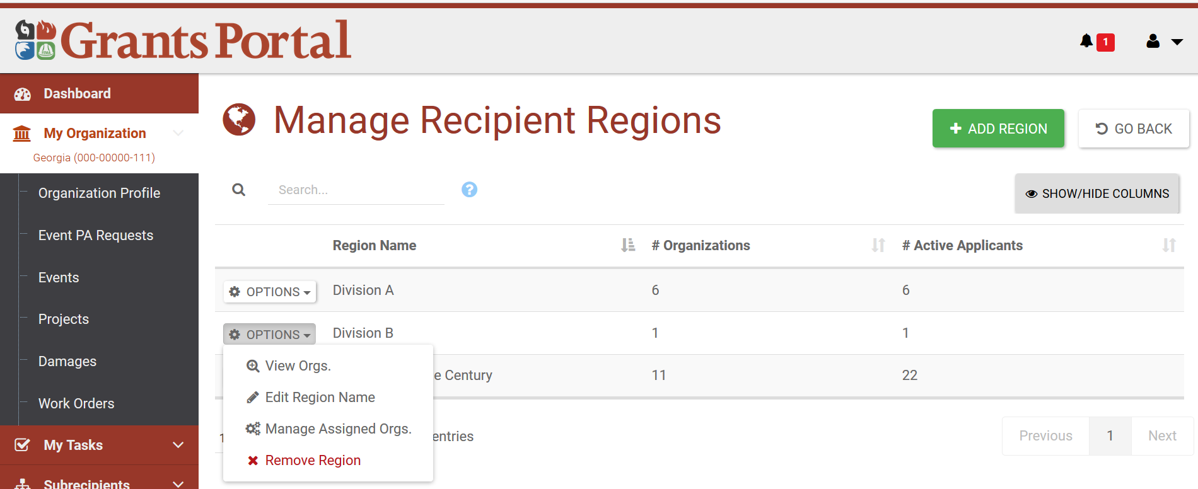
Recipient “Recipient Regions” Area
Profile / Organization Profile / Recipient Regions / Region
Notes:
Once a Recipient Region is created they can Select Options to View, Edit, Manage, or Remove

Slide 20
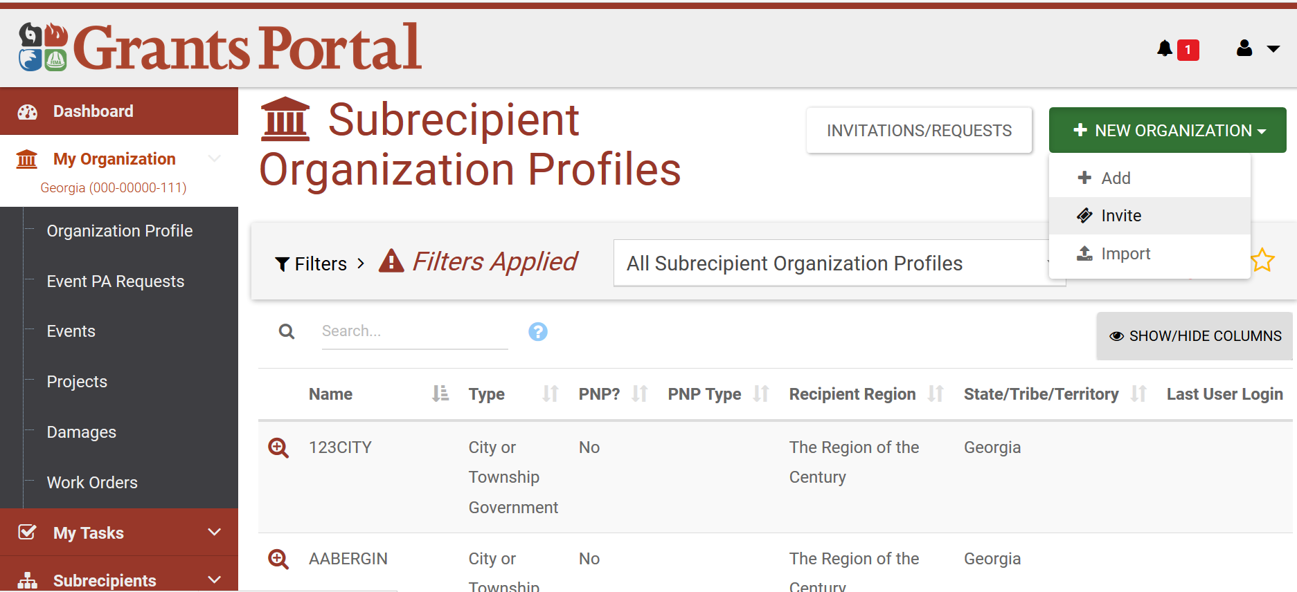
Recipient “Organizations” Area
Profile / Organization Profile / Subrecipient Organization Profiles

Slide 21
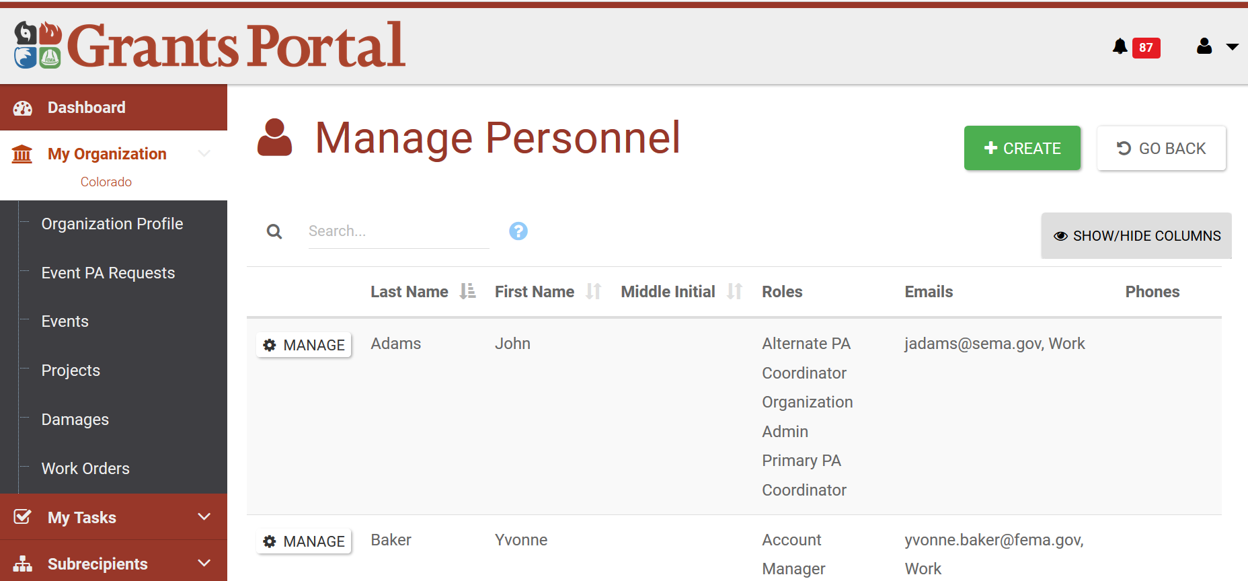
Recipient “Organizations” Area
Profile / Organization Profile / Personnel

Slide 22
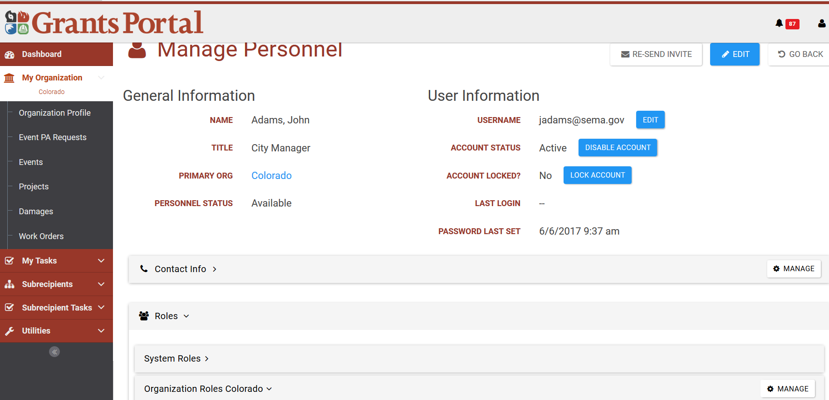
Recipient “Organizations” Area
Profile / Organization Profile / Personnel / Manage

Slide 23
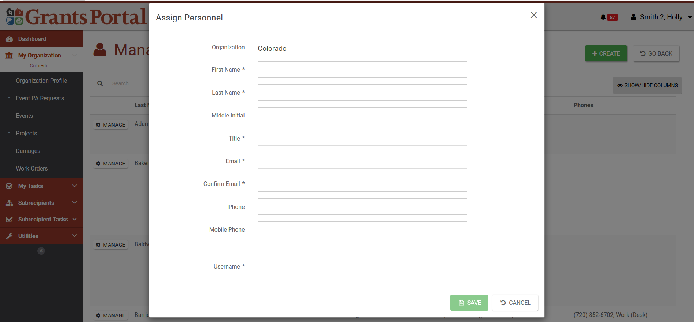
Recipient “Organizations” Area
Profile / Organization Profile / Personnel / Create

Slide 24
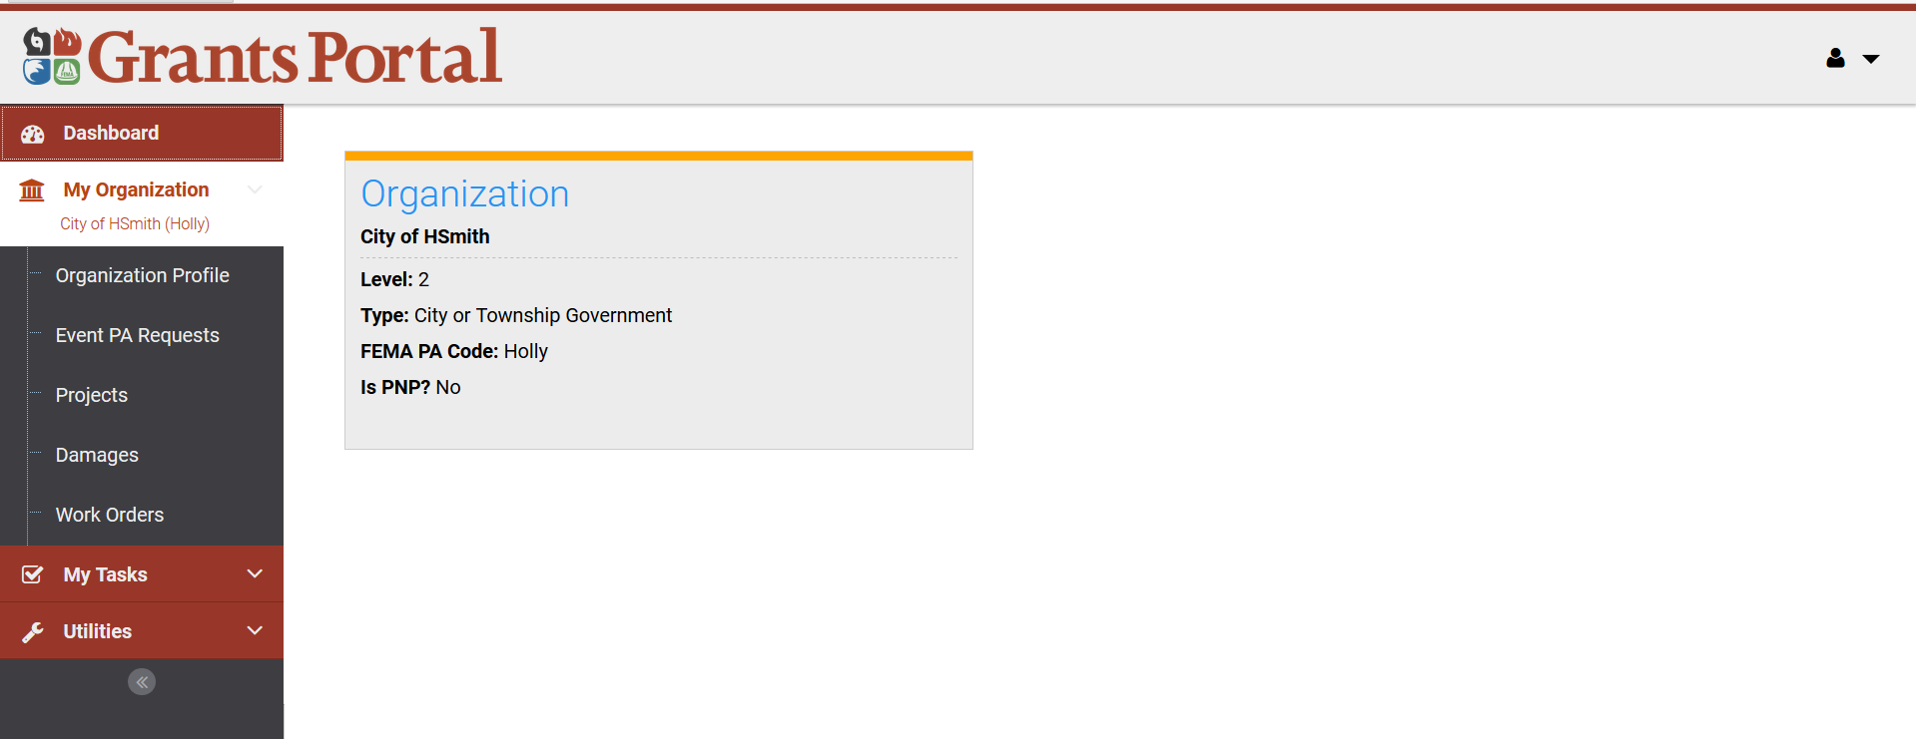
Applicant “Dashboard” Screen
Profile

Slide 25
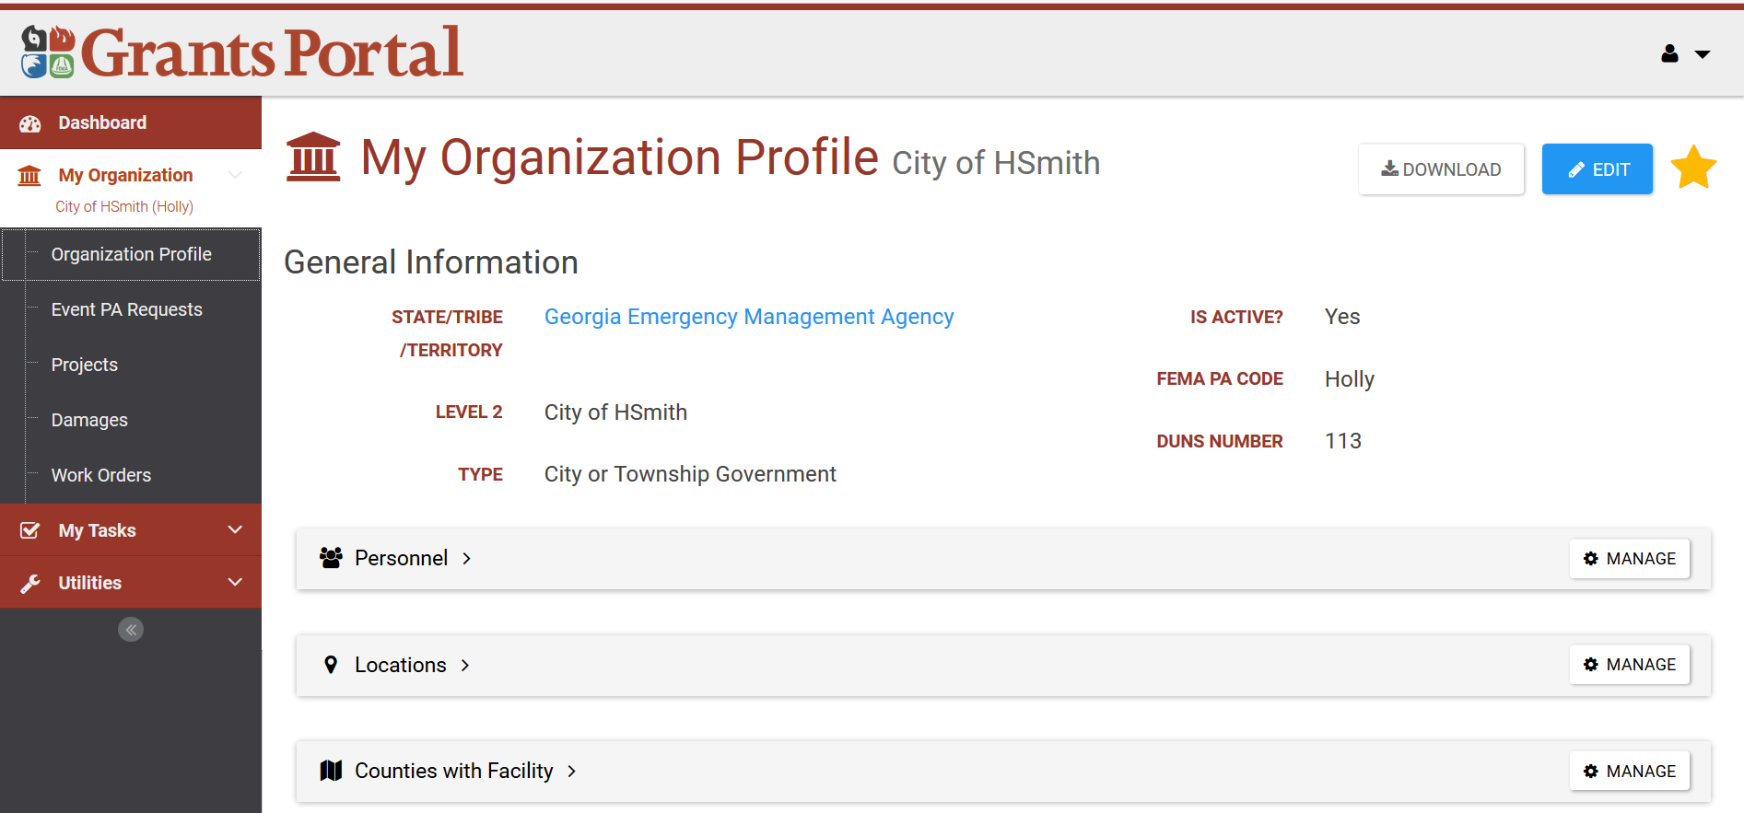
Applicant “My Organization” Area
Profile / Organization Profile

Slide 26
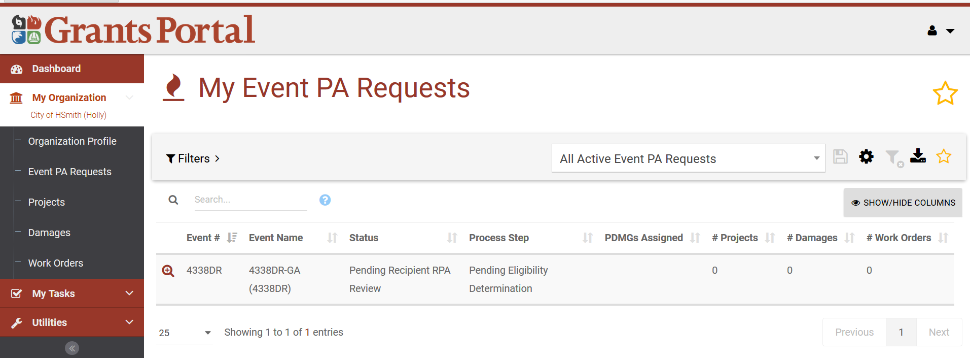
Applicant “Events” Area
Profile / Event PA Request

Slide 27
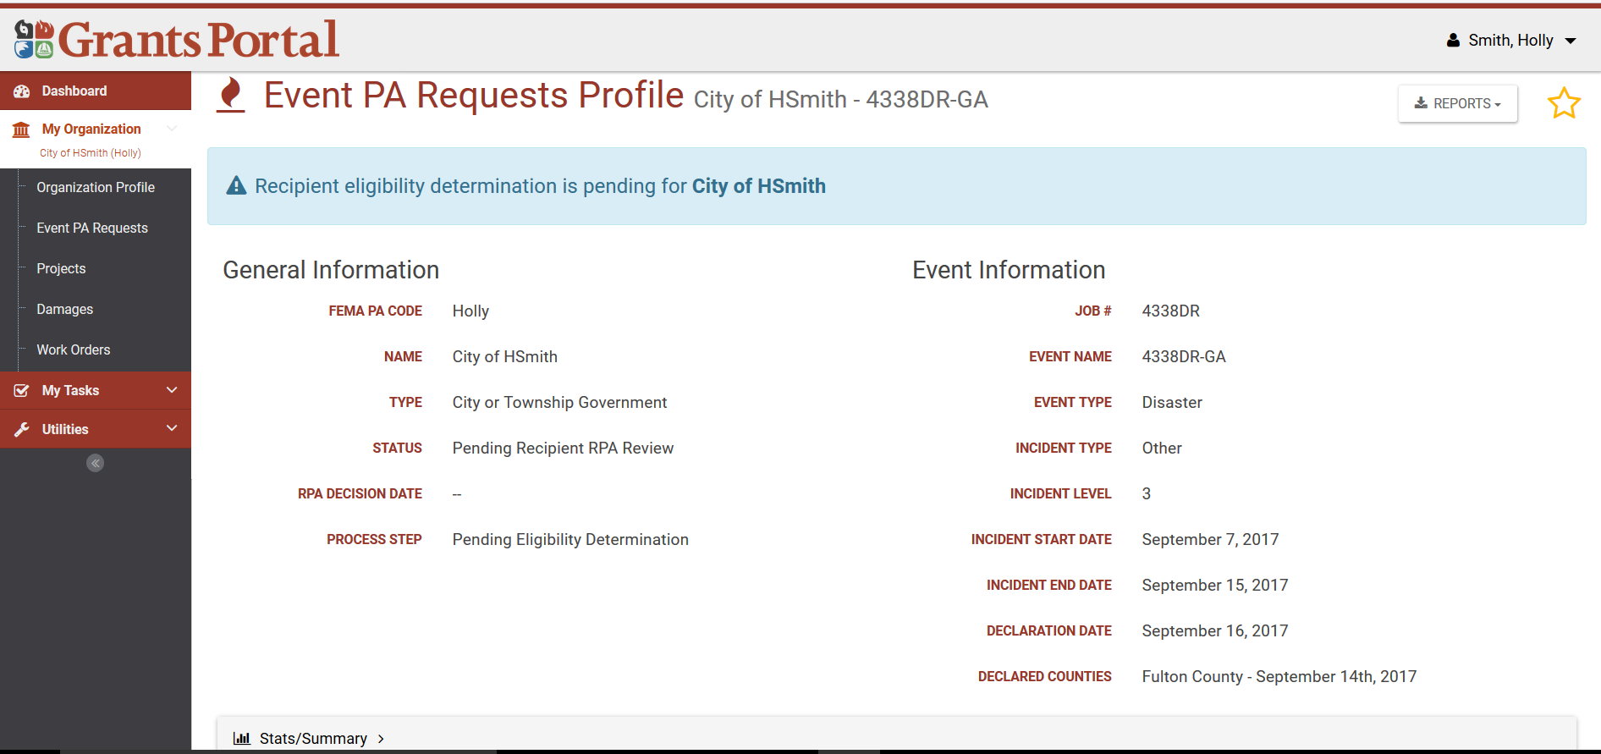
Applicant “Event PA Requests” Area
Profile / Event PA Request / Event Number

Slide 28
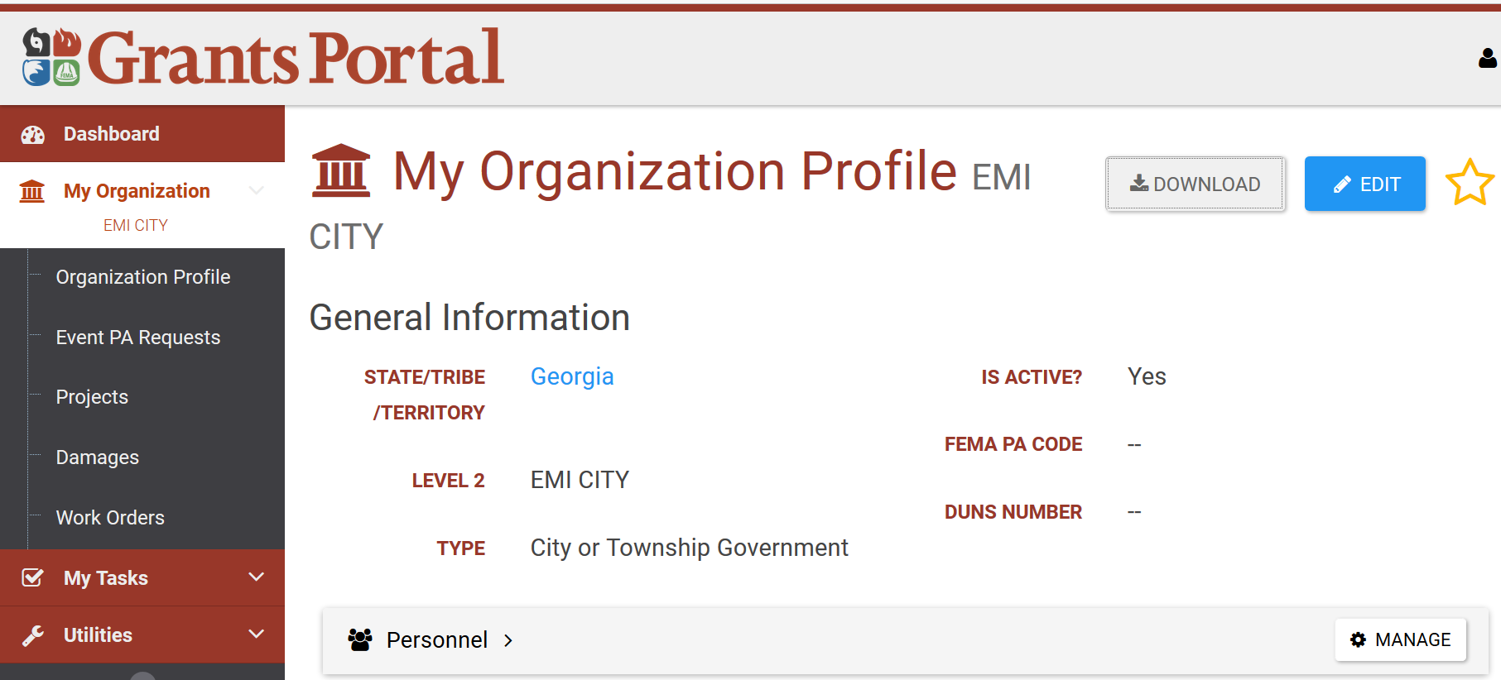
Recipient / Applicant “Organization Profile Download” Area
Profile / Organization Profile

Slide 29
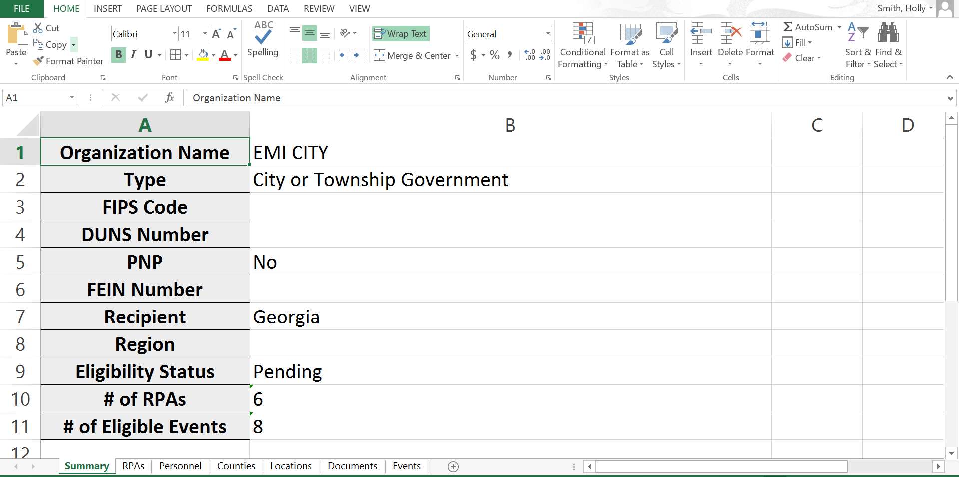
Recipient / Applicant “Organization Profile Download” Area
Profile / Organization Profile / Download

Slide 30
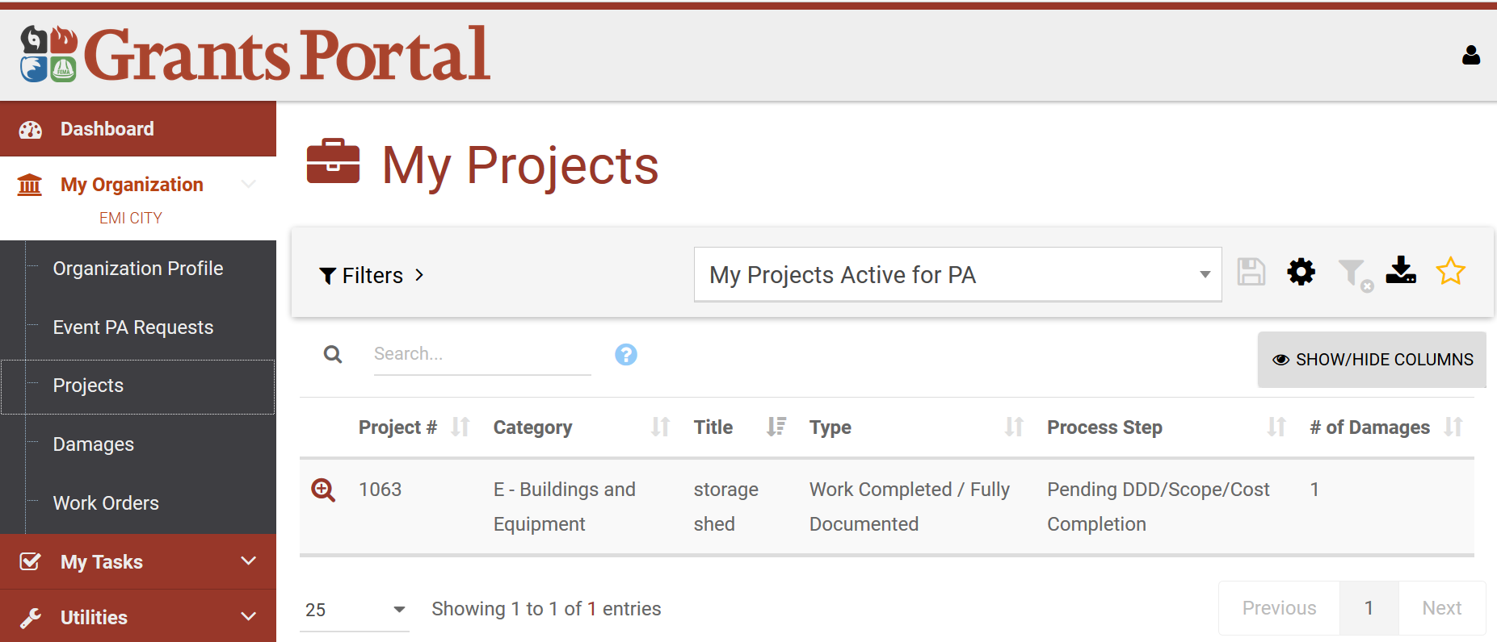
Recipient / Applicant “Projects” Area
Profile / Projects

Slide 31
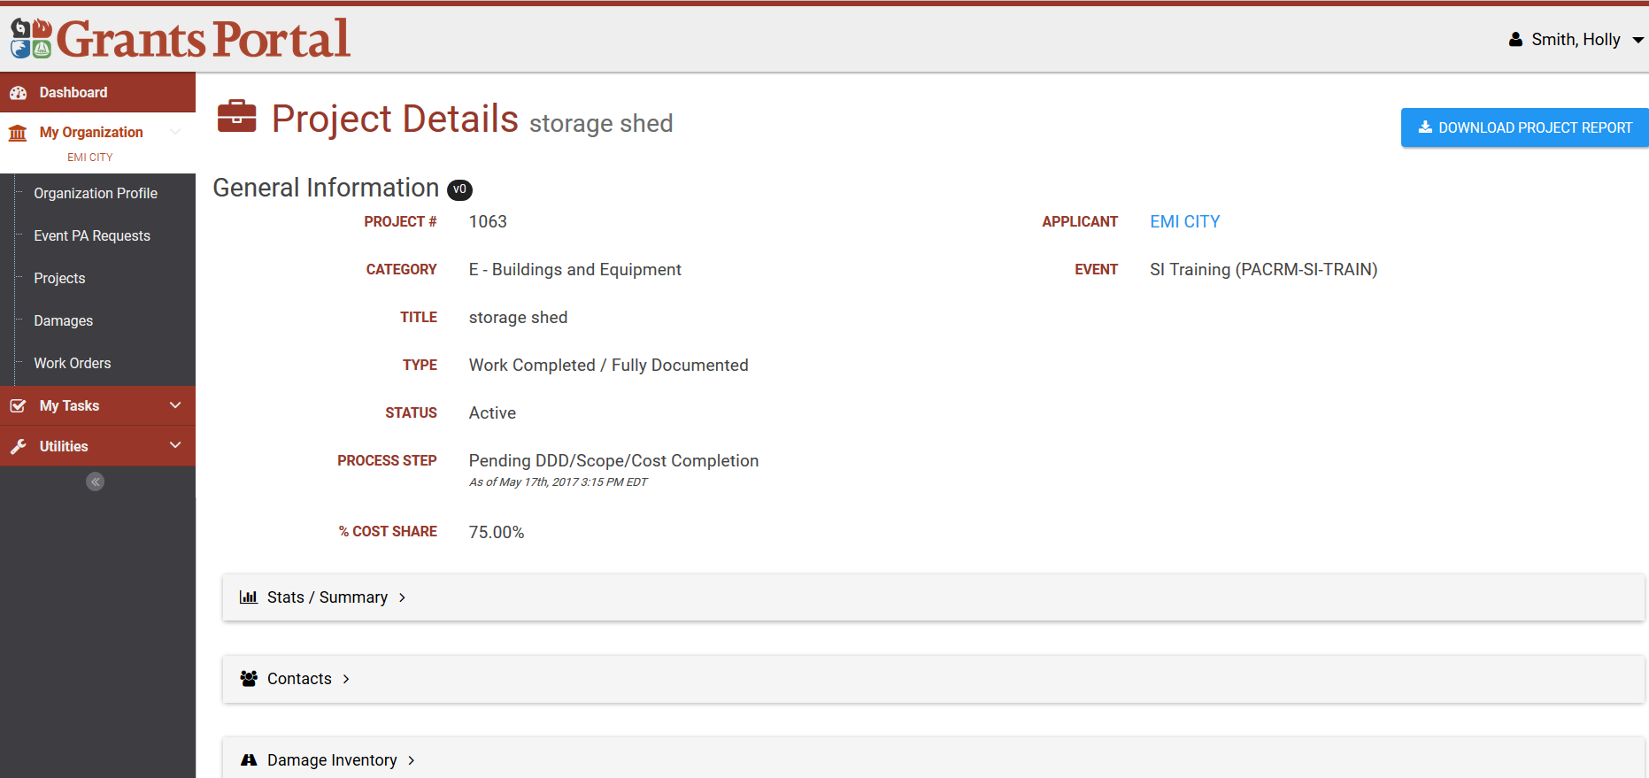
Recipient / Applicant “Projects” Area
Profile / Projects / Project Number

Slide 32
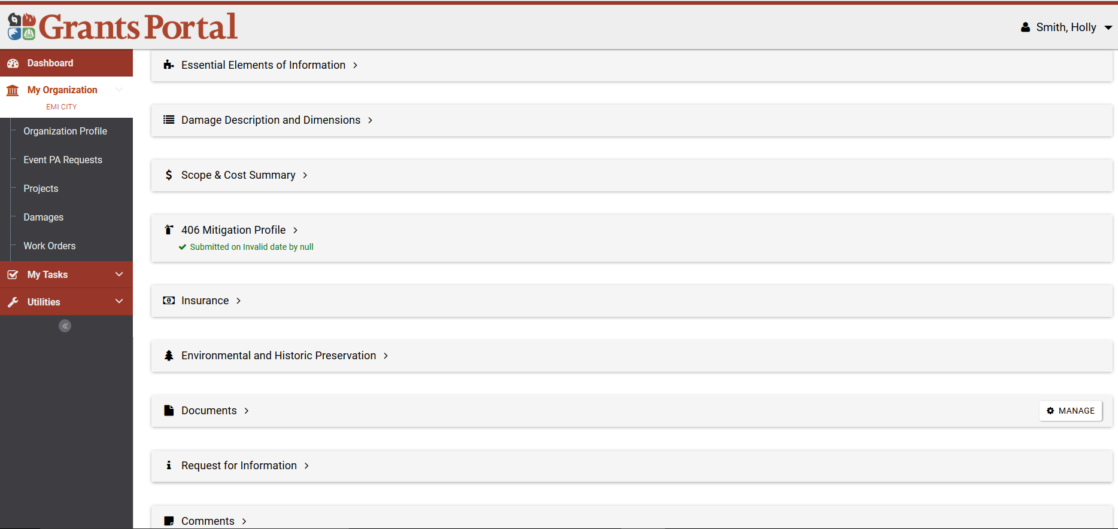
Recipient / Applicant “Projects” Area
Profile / Projects / Project Number Cont.

Slide 33
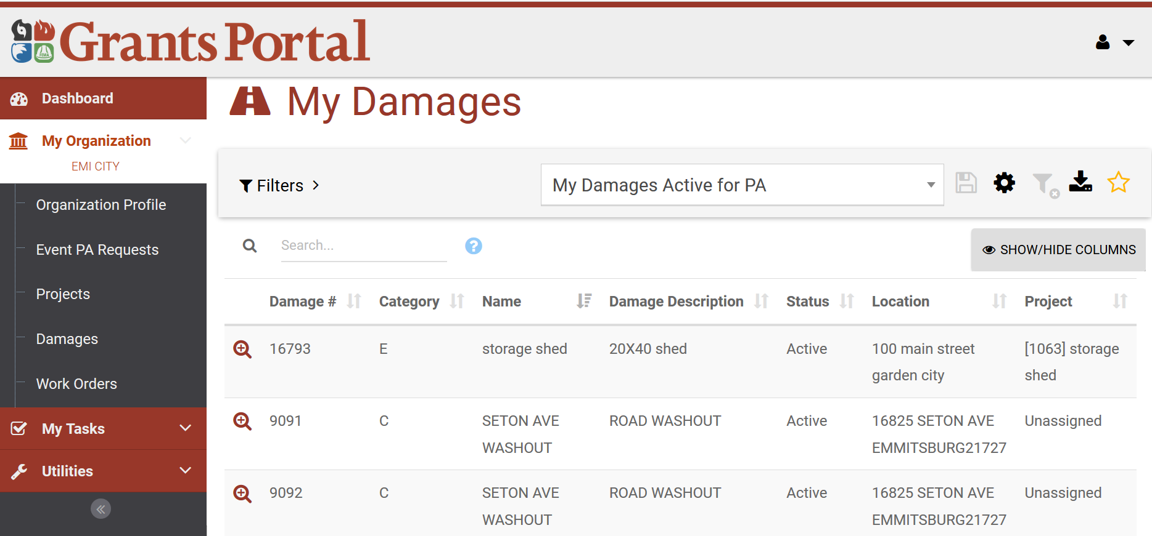
Recipient / Applicant “Damages” Area
Profile / Damages

Slide 34
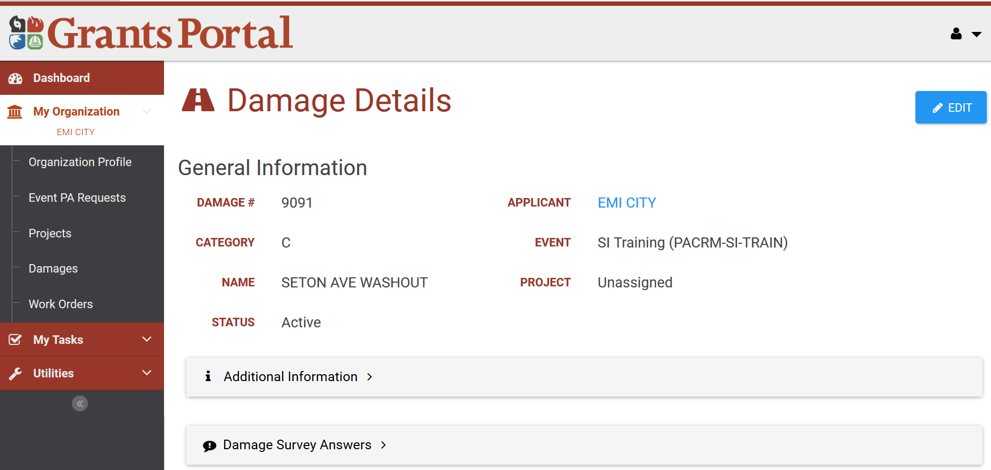
Recipient / Applicant “Damages” Area
Profile / Damages / Damage Number

Slide 35
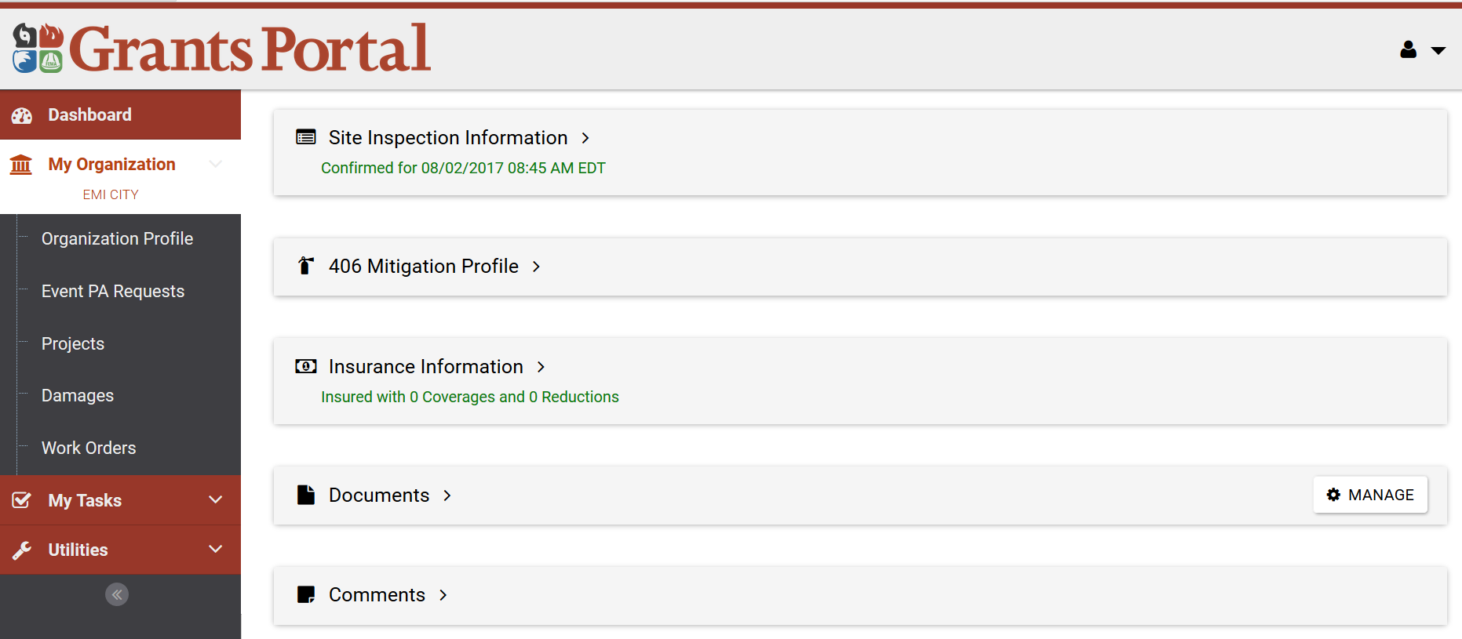
Recipient / Applicant “Damages” Area
Profile / Damages / Damage Number Cont.

Slide 36
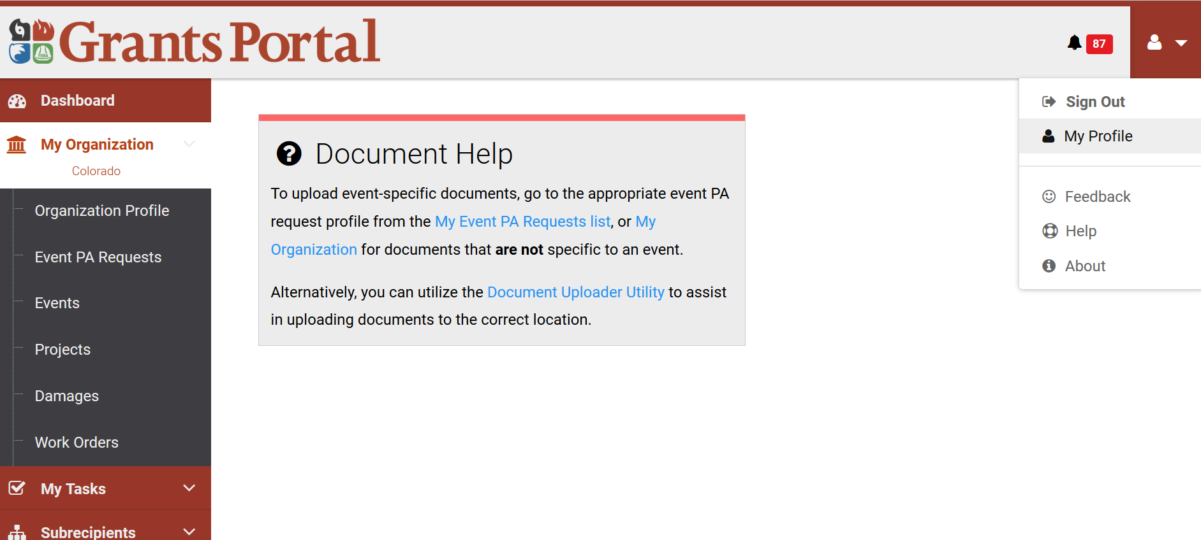
Recipient / Applicant Your Personal Profile
Profile

Slide 37
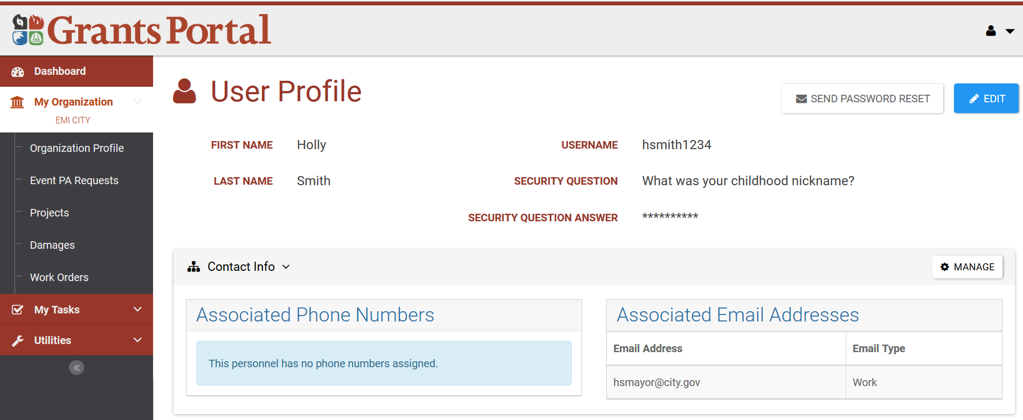
Recipient / Applicant Your Personal Profile
Profile / My Profile

Slide 38
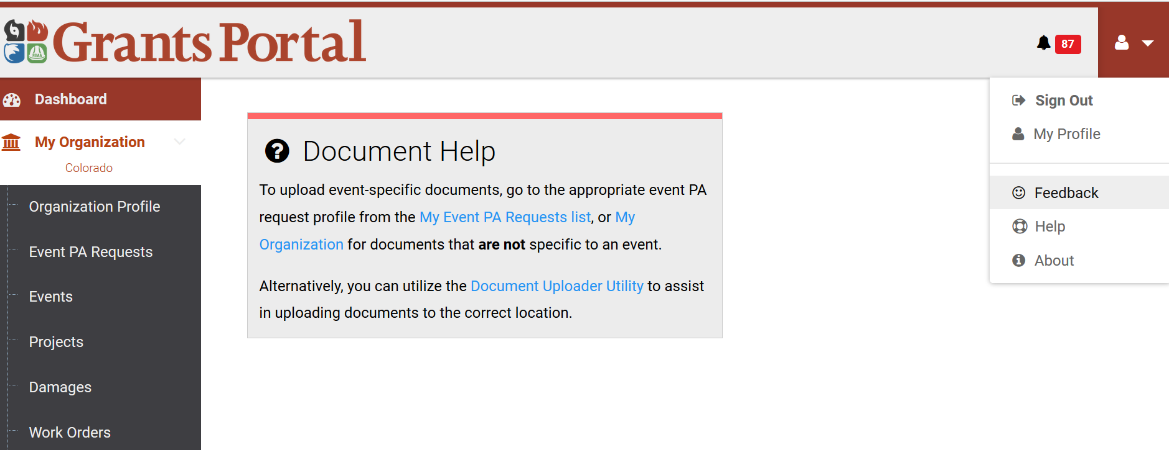
Recipient / Applicant Submitting Feedback
Profile / Feedback

Slide 39
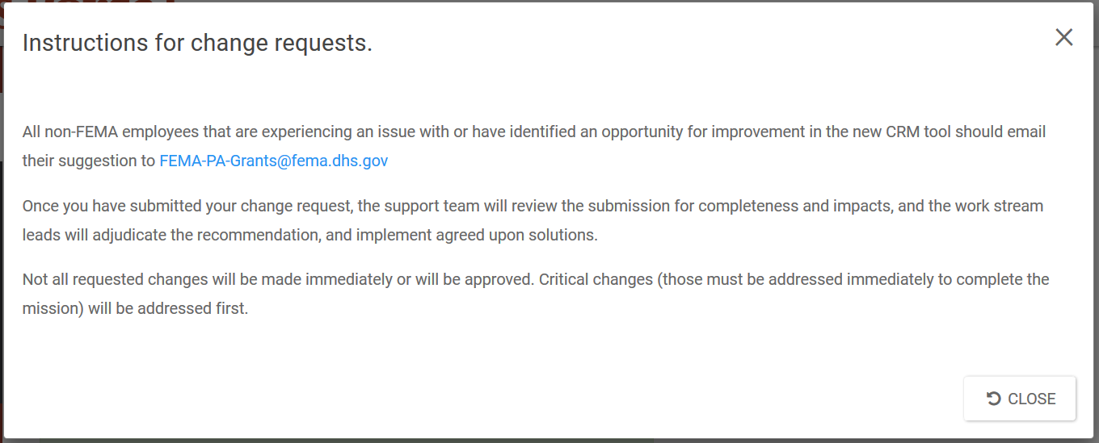
Recipient / Applicant Submitting Feedback
Profile / Feedback / Popup

Slide 40
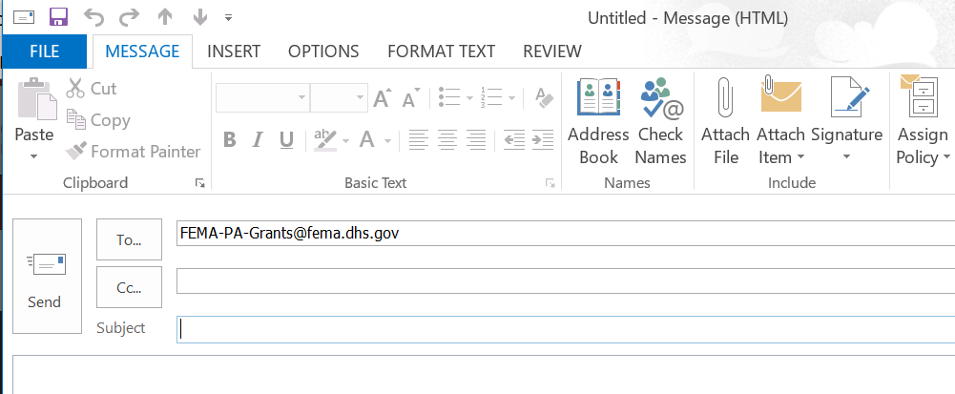
Recipient / Applicant Submitting Feedback
Profile / Feedback / Popup / Link
Clicking on the Feedback hyperlink opens up an email to add your suggestions or concerns with regard to the Grants Portal system.

Slide 41
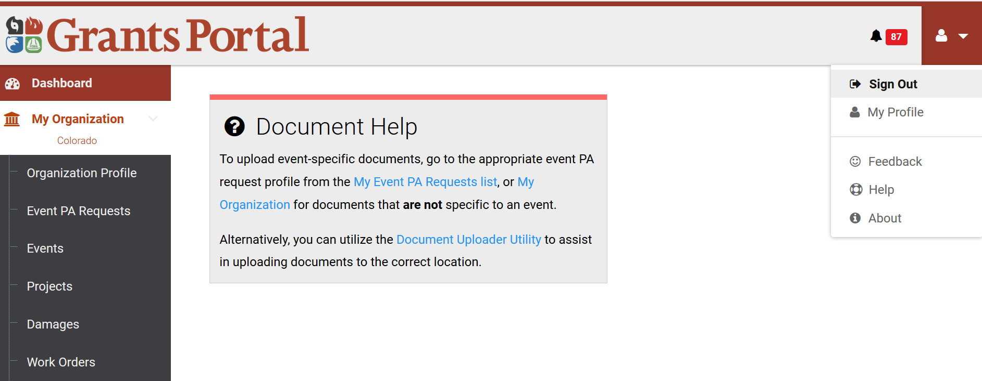
Signing Out
Profile / Sign Out

Slide 42

Questions
Notes:
Instructor Notes:
– Take brief moment to address any final questions before proceeding.

Slide 43

Conclusion of Unit 2
Course Evaluation and Comment
Notes:
Instructor Notes:
Have students complete the Unit 2 portion of the evaluation. Include time for comments and feedback.

